Slide 1

Project: Implementation of Iron Condor Entry Strategy
By:
Brandon W
Tyler W
Manish K
Anurag R
Notes:
Title Slide

Slide 2
Motivation and Summary
Define the core message or hypothesis of your project.:
Implementation of Iron Condor Entry Strategy for identified underlying
Describe the questions you asked, and why you asked them.
To execute the strategy we need to identify 4 options for entering into trade
Which of following to pick:
2 pair of short and long -all call, or
2 pair of short and long -all put, or
1 pair call options & 1 pair put options?
ITM vs OTM? ITM are illiquid and infrequent trade.=> wider bid-ask spread & higher transaction cost
which maturity date?
Theta Decay play
which strike price?
historical probability advantage
vertical skew
risk return trade off
Delta (Price Risk) minimization
Notes:
Motivation/Summary Slide

Slide 3
Motivation and Summary
Summary: Background Research and Project
Strategy implementation through selling an OTM call credit spread and an OTM put credit spread has demonstrated advantage
Maturity date in the range between 15 and 75 days
Project endeavor attempted to find the strike prices of option legs and optimal maturity dates using
risk return trade off
delta (price) risk minimization
addressing volatility skew
data source: TD Ameritrade Option Chain API and Yahoo Finance’s Library
Project Way forward::
Backtesting of strategy
Implementation to pick best underlying
Implementation of Adjustment and exit strategy
Notes:
Motivation/Summary Slide

Slide 4
Questions and Data
Questions
The Questions proposed need very specific data requirements in order to complete the calculations
Greeks
ITM or OTM
Maturity Date
Strike Price
Data
Data was sourced using TD Ameritrade’s Options API
This gave a live dataframe of various options data
Fundamental stock data was sourced from Yahoo Finance’s library
Notes:
Questions/Data Slide

Slide 5
Data Cleanup and Exploration
Data was taken from TDA as JSON, so it needed to be converted to a dataframe
The API downloaded data from TDA had extra data that was not needed
Specific columns needed to be coded into a variable format, for use in later functions
Notes:
Data Cleanup/Exploration Slide

Slide 6
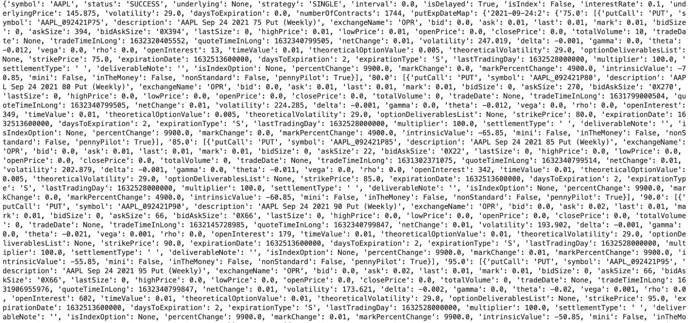

Slide 7
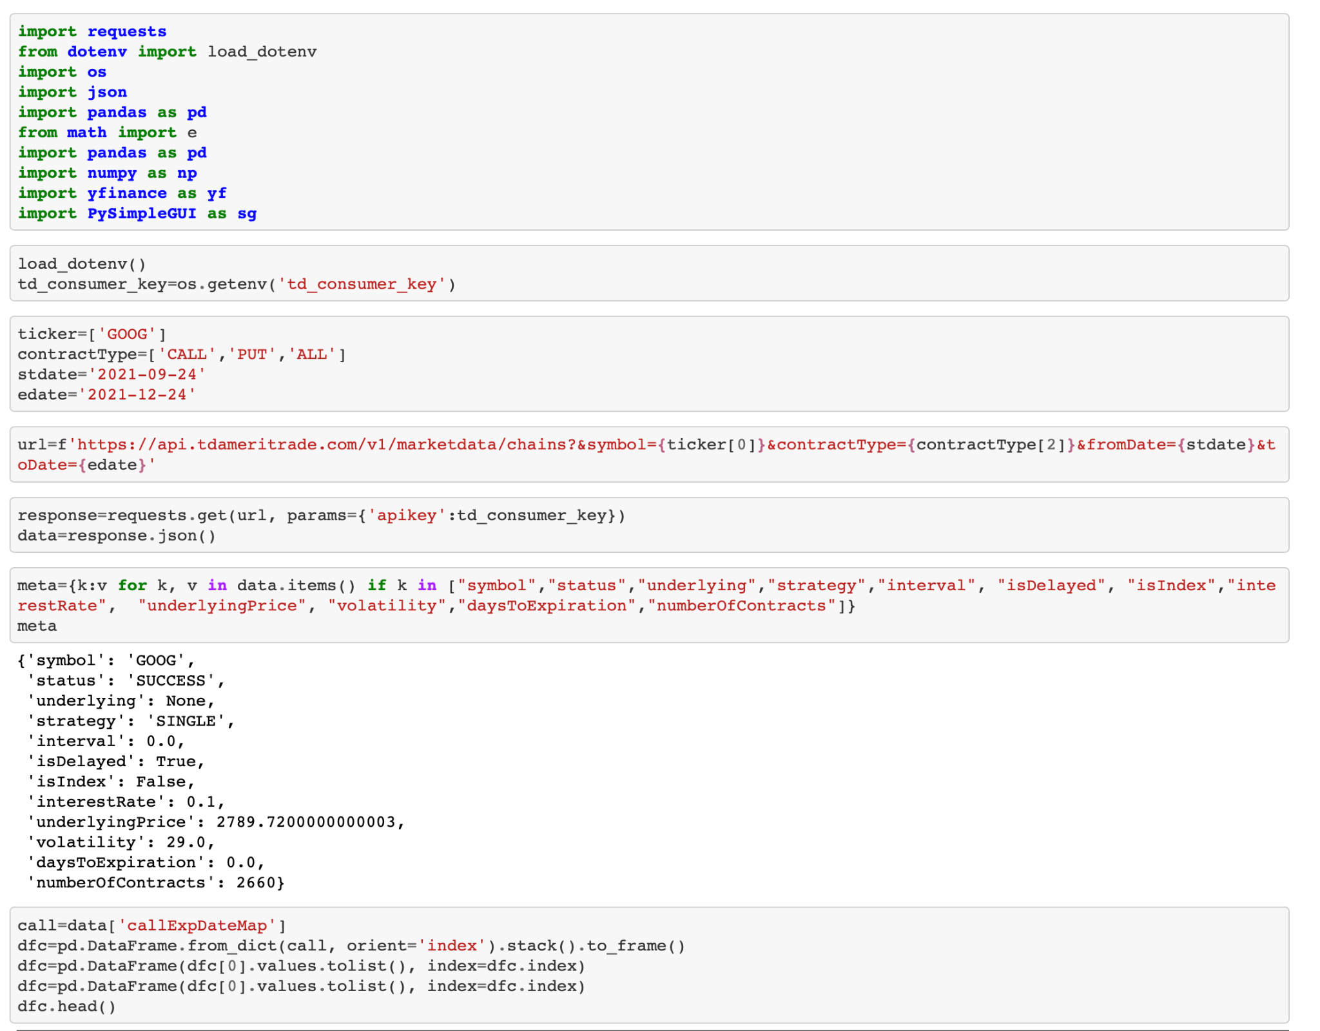

Slide 8
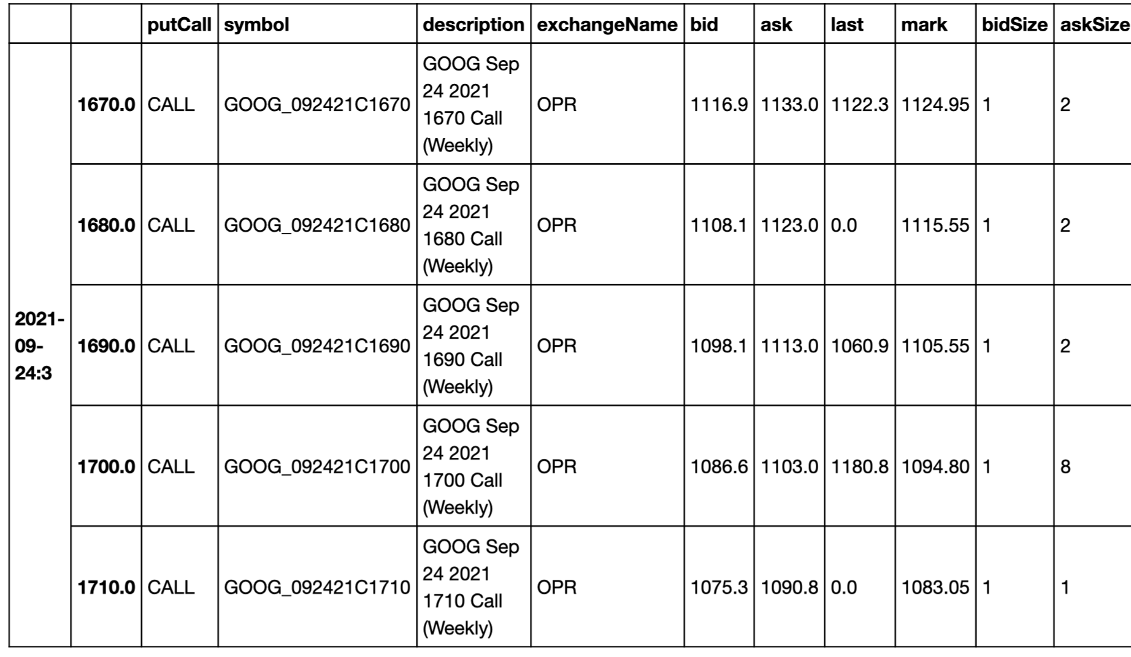
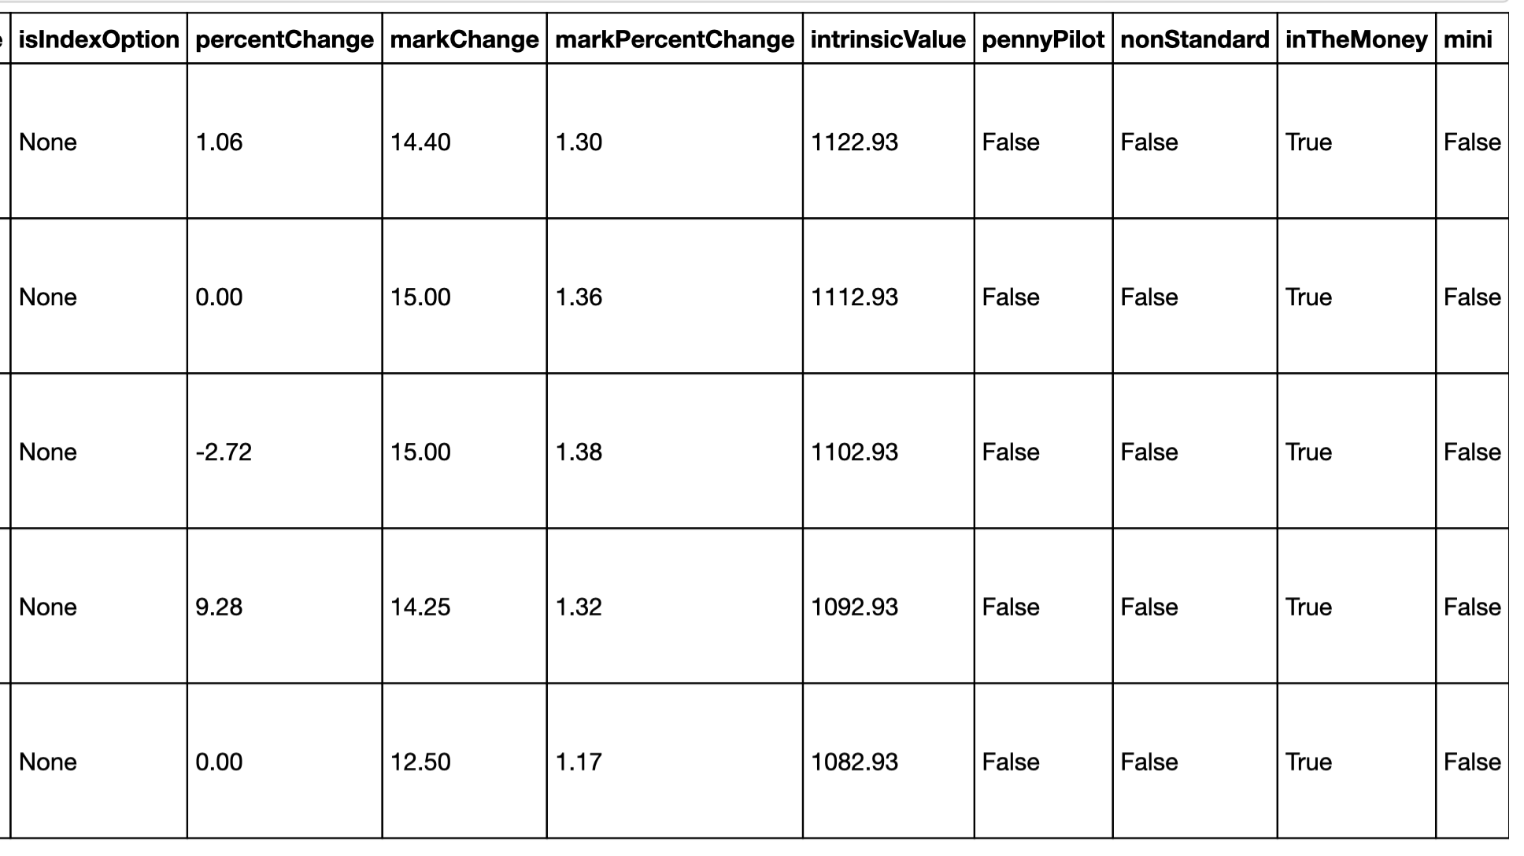

Slide 9
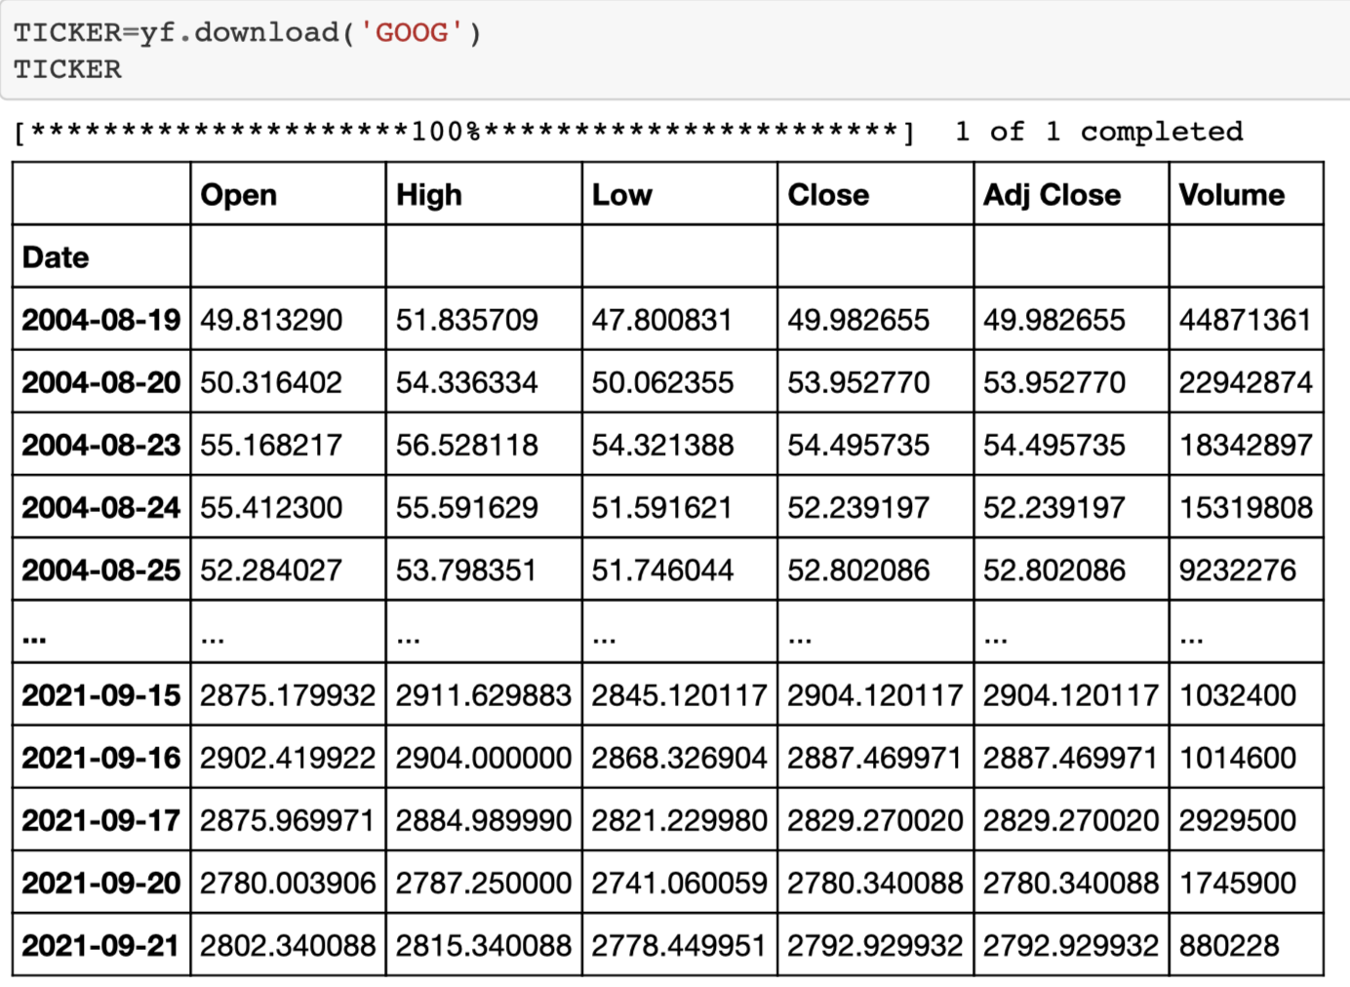

Slide 10
Data Analysis
Logic used to analyse the data for Risk return ratios
Number of Calendar days in Holding Period for comparison of risk return ratios of different candidate options, HPD = 3
Daily Volatility of Implied Volatility, DVIV = calculated basis price change of stock for recent past 5 days
IV = Annualized Implied Volatility
Expected Price Change, EPC = P * (Exp (IV*((HPD/365) ^ 0.5))-1)
ECIV, Expected Change in Implied volatility = DVIV * ((HPD)* 5/7))^0.5)
Risk Return Effect
Vega Effect, VE = -ABS(Vega) * ECIV
Theta Effect, TE = Theta * HPD
Delta Effect (DE) = -ABS(Delta)* EPC
Gamma Effect (GE) = Gamma * (EPC^2)/2
Risk Return Ratio
VTRRR = (VE/TE)
DTRRR = (DE +GE)/TE
Risk Return Ratio, RR = DTRRR+ VTRRR
Notes:
Data Analysis Slide

Slide 11
Data Visualization- Brandon and Tyler
Present and discuss interesting figures developed during analysis, ideally with the help of Jupyter Notebook.

Slide 12
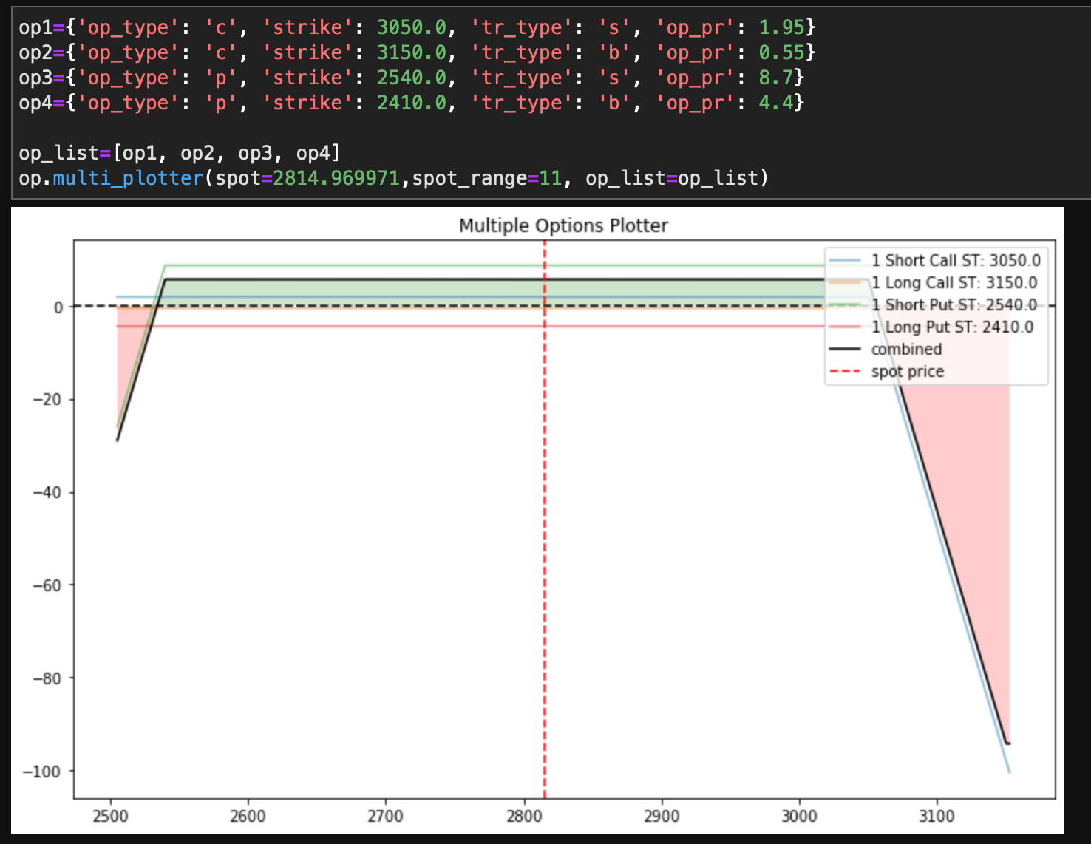
What the Ion condor looks like

Slide 13
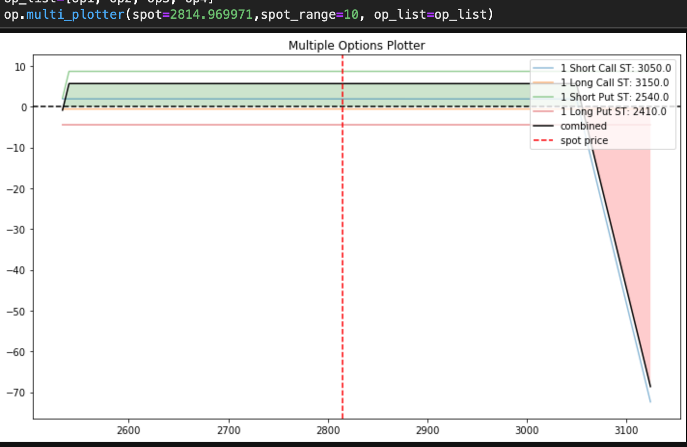

Slide 14
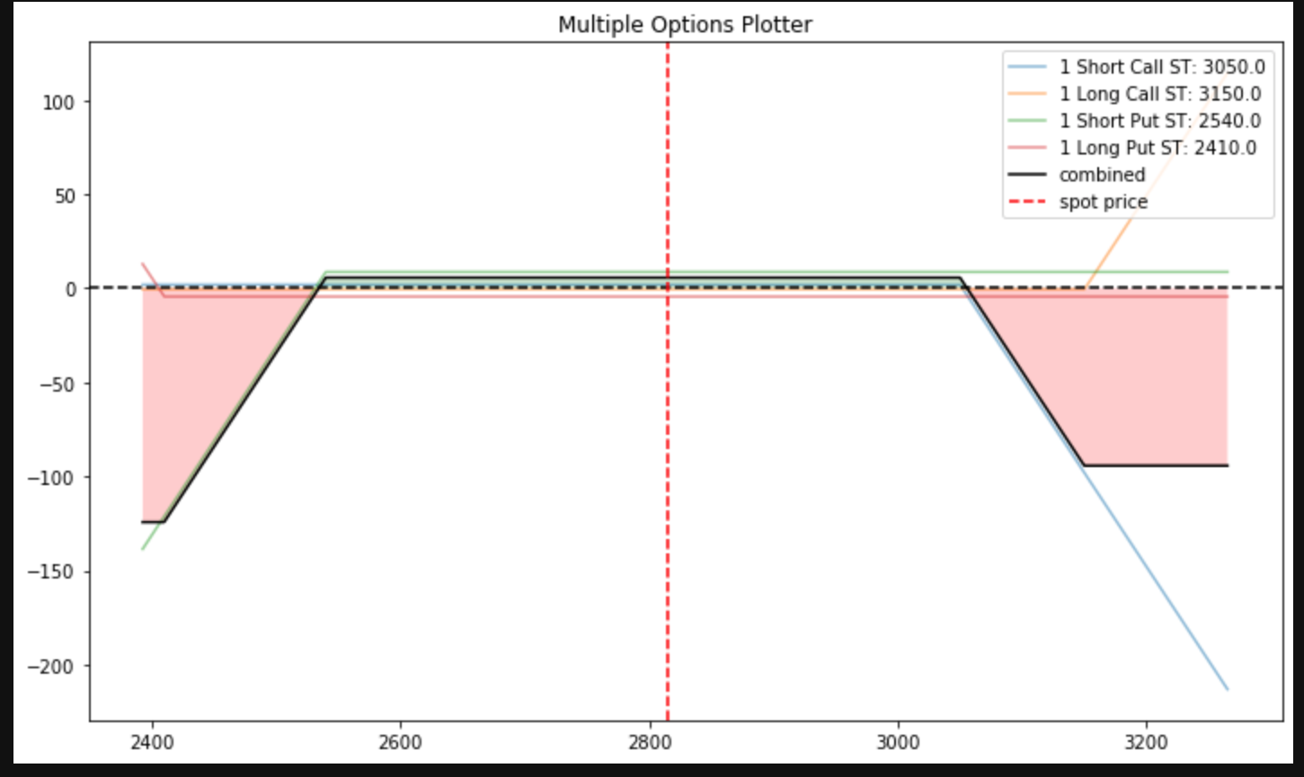

Slide 15
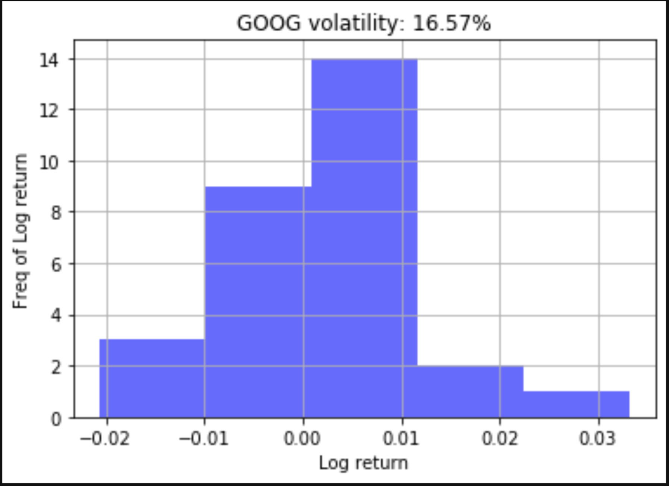

Slide 16
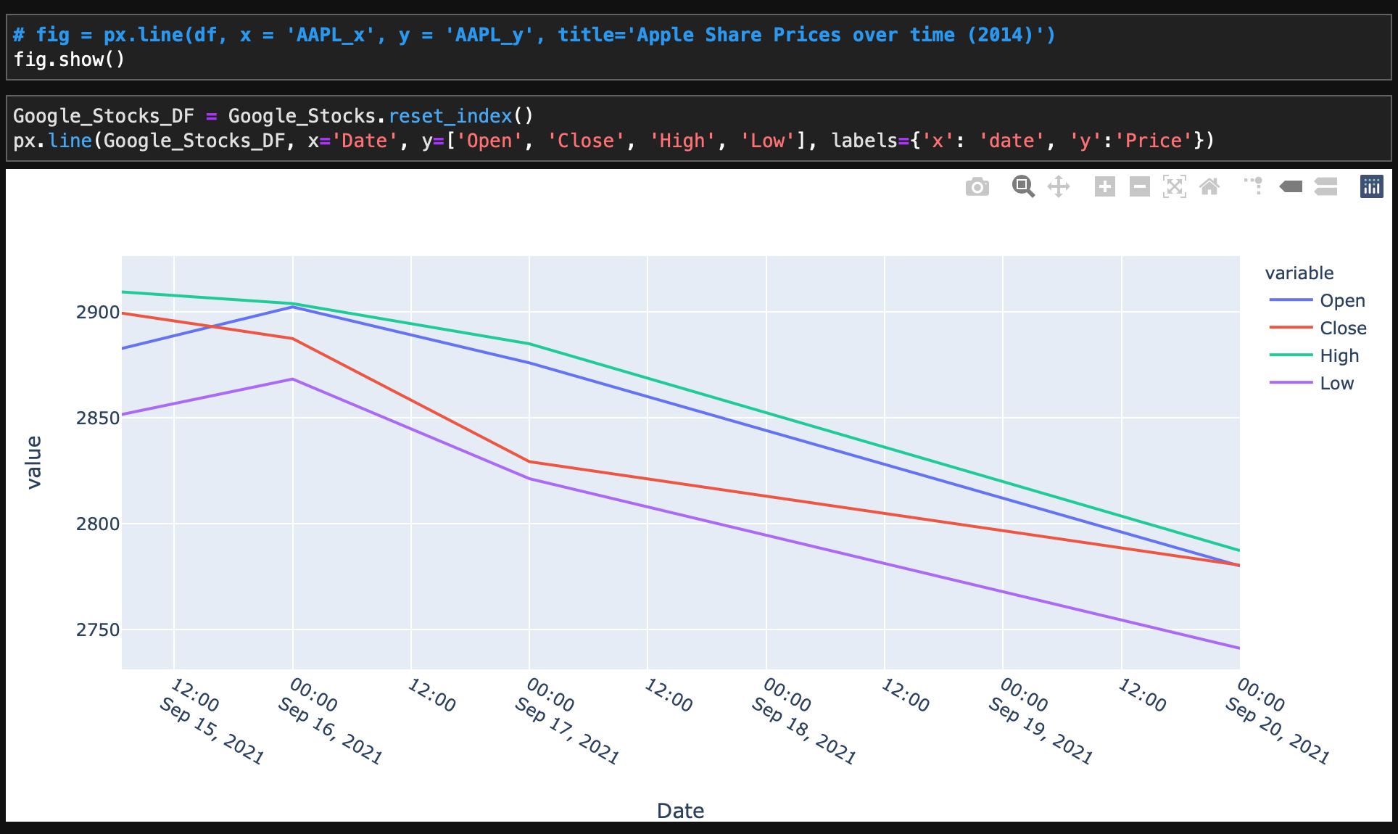

Slide 17
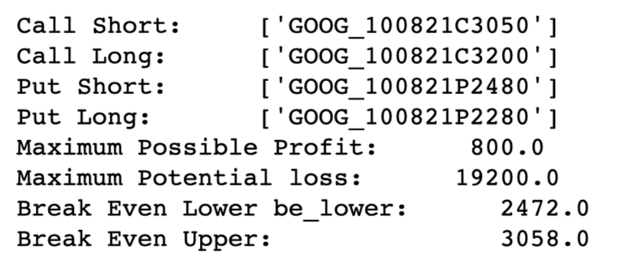
Results
Code takes in data sourced from TDA and Yahoo and gives an output recommendation on what Iron Condor to buy
Notes:
Discussion Slide

Slide 18
Postmortem
Discuss any difficulties that arose, and how you dealt with them.
Discuss any additional questions that came up, but which you didn't have time to answer: What would you research next, if you had two more weeks?
Converting Data that TDA provided from they’re API to a more manageable and viewable dataframe for data cleaning and analysis
Converted JSON into dataframe structure using Pandas built in functionality
We tried user input for investment time horizon, but could not close on this and hence excluded that piece
Converting certain data into Iron Condor visualizations was challenging
Was unsuccessful at plugging in dynamic variables into Iron Condor visualization
This is still rudimentary, but does the job!
Future Progress:
User risk preference
How much user wants to invest
How much time willing to invest
Automation of Trade!
Notes:
Postmortem Slide

Slide 19
Q&A

